Slide 1
What Drives Zestimate?
Data from
May 1st, 2017 – June 30th 2017
R-squared = 46.6

Slide 2
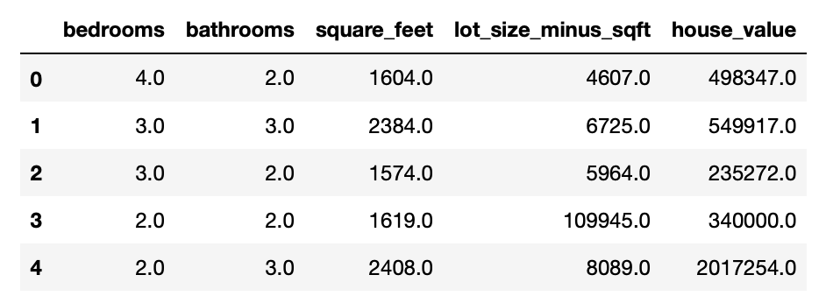

Slide 3
RSME ~ $452,000
R-squared = 46.6%

Slide 4
Conclusion
Distribution of Residuals
Normally distributed residuals
Problem with multicollinearity
R-squared = .466

